Slide 1
Unsupervised Learning
Dr. Sugata Ghosal
CSIS Off-Campus Faculty
BITS Pilani

Slide 2
In This Segment
What is Unsupervised Learning
Applications of Unsupervised Learning
Dimensionality Reduction and Feature Extraction
Clustering

Slide 3
Unsupervised Learning
We only use the features X, not the labels Y
This is useful because we may not have any labels but we can still detect patterns
For example:
We can detect that news articles revolve around certain topics, and group them accordingly
Discover a distinct set of objects appear in a given environment, even if we don’t know their names, then ask humans to label each group
Identify health factors that correlate with a disease
Group items that “belong together” (i.e. have similar features)
Projecting the high-dimensional data onto lower dimensional space

Slide 4
Applications
Two Primary Applications
Feature extraction via dimensionality reduction
for subsequent supervised classification or data exploration
Grouping the data via clustering into similar groups.

Slide 5


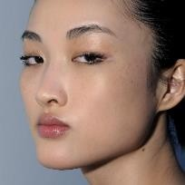
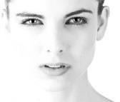

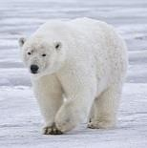
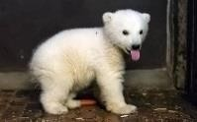
Feature Discovery

Slide 6
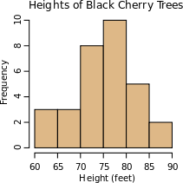
Why do we cluster?
Counting
Feature histograms: by grouping similar features and counting how many of each a data sample has
Summarizing data
Look at large amounts of data
– Represent a large continuous vector with the cluster number
Prediction
Data points in the same cluster may have the same labels
Ask a human to label the clusters

Slide 7
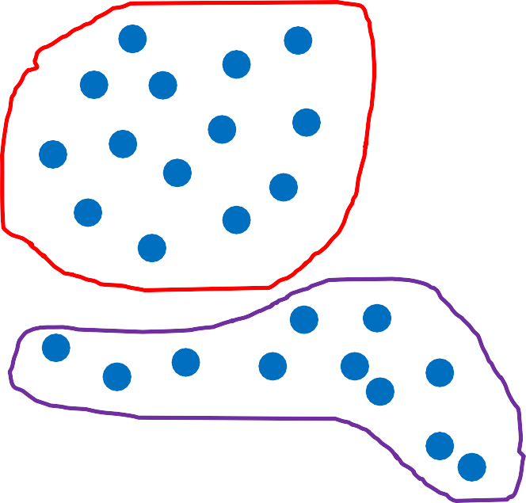



Why do we cluster?
Cluster, then ask human to label groups
Compute a histogram to summarize the data
1
“cat”
2
"panda”
Count in this sample
3
“giraffe”
Feature cluster

Slide 8
Thank You!
In our next segment: PCA

Slide 9
Principal Component Analysis
Dr. Sugata Ghosal
CSIS Off-Campus Faculty
BITS Pilani

Slide 10
In This Segment
What is PCA?
Why PCA?
Problem Formulation
Eigenfaces
Image Compression

Slide 11
A vector representing measurable characteristics of a data sample we have
E.g. a glass of juice can be represented via its color = {yellow=1, red=2, green=3, purple=4} and taste = {sweet=1, sour=2}
For a given glass i, this can be represented as a vector: xi = [3 2] represents sour green juice
For D features, this defines a D-dimensional space where we can measure similarity between samples

Slide 12



2
taste
1
0
1
2
color
3
4

Slide 13
Motivation
A way to simplify complex high-dimensional data
Summarize data with a lower dimensional real valued vector
Given data points in d dimensions
Convert them to data points in r<d dimensions
With minimal loss of information

Slide 14
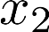
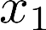
Data Compression
Reduce data from
2D to 1D
(inches)
(cm)
Andrew Ng

Slide 15
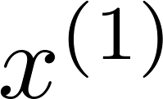
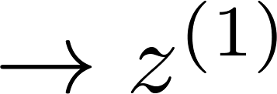
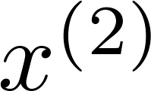
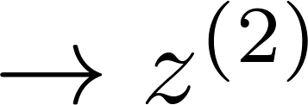
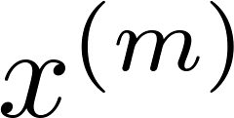
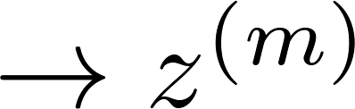
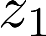
Data Compression
Reduce data from
2D to 1D
(inches)
(cm)
Andrew Ng
Notes:
Add more unique colors (3-4)

Slide 16
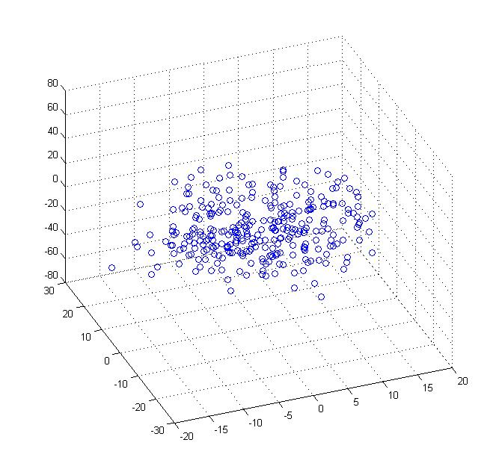
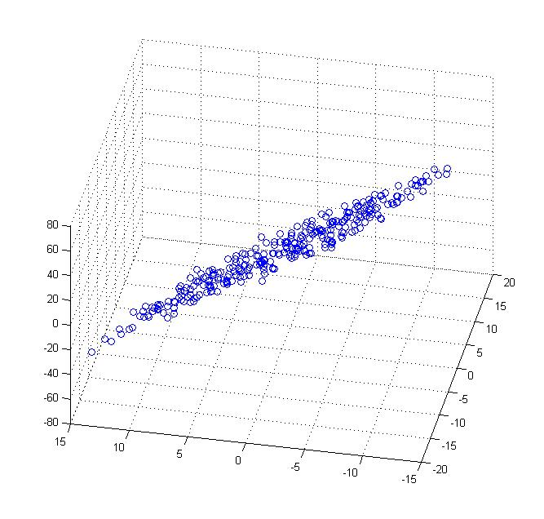
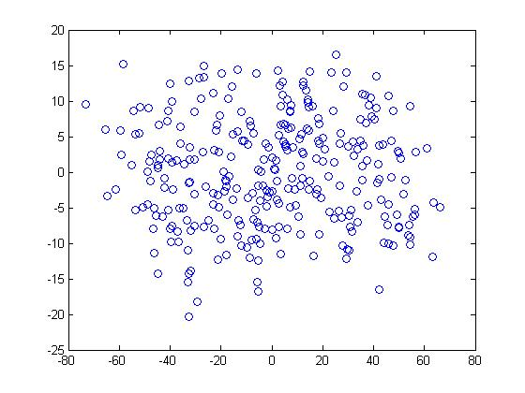
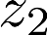
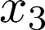
Data Compression
Reduce data from 3D to 2D
Andrew Ng
Notes:
Pca3d2d in lecture-slides/assets/pca/
Label axes

Slide 17
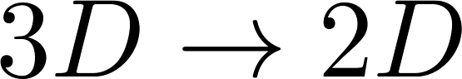
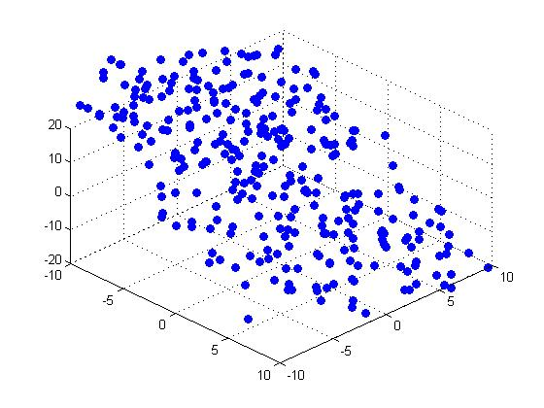
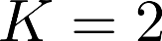
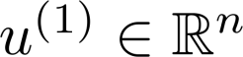
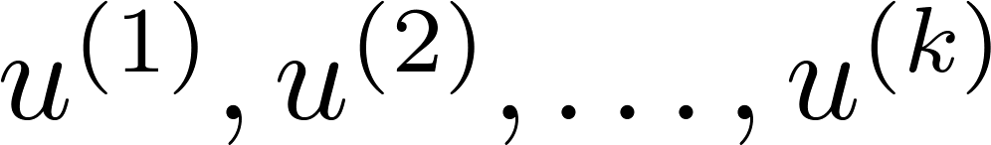
PCA Problem Formulation
Reduce from 2-dimension to 1-dimension: Find a direction (a vector )
onto which to project the data so as to minimize the projection error.
Reduce from n-dimension to k-dimension: Find vectors
onto which to project the data, so as to minimize the projection error.
Andrew Ng
Notes:
Change numbers to LATEX as well

Slide 18
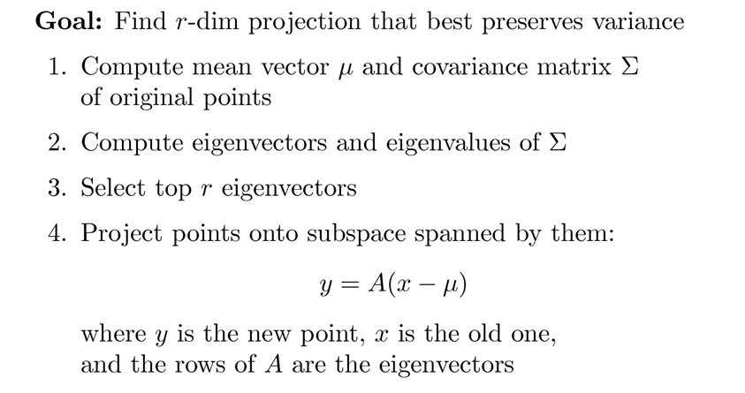
Principal Component Analysis

Slide 19
Covariance
Variance and Covariance:
Measure of the “spread” of a set of points around their center of mass(mean)
Variance:
Measure of the deviation from the mean for points in one dimension
Covariance:
Measure of how much each of the dimensions vary from the mean with respect to each other
Covariance is measured between two dimensions
Covariance sees if there is a relation between two dimensions
Covariance between one dimension is the variance

Slide 20
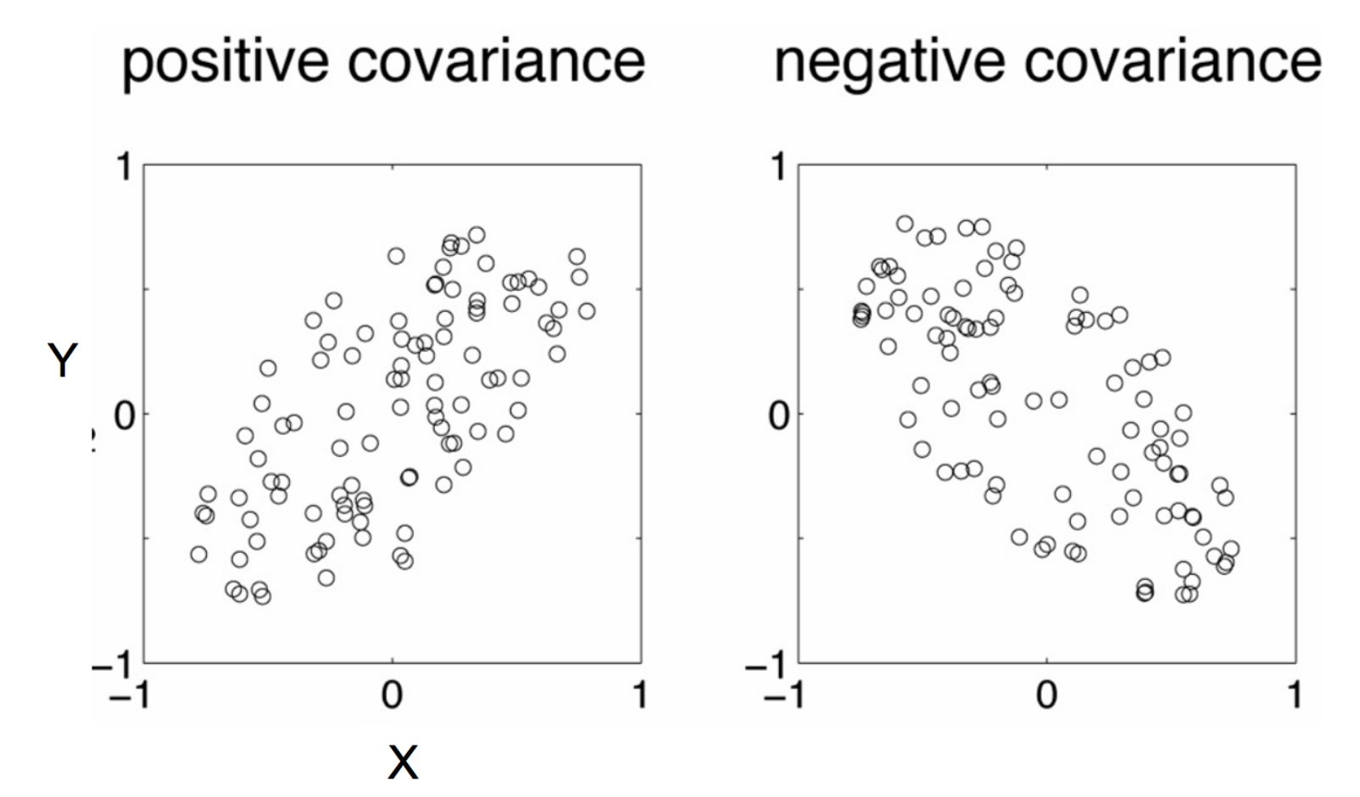
Negative: While one increase the other decrease
Positive: Both dimensions increase or decrease together

Slide 21
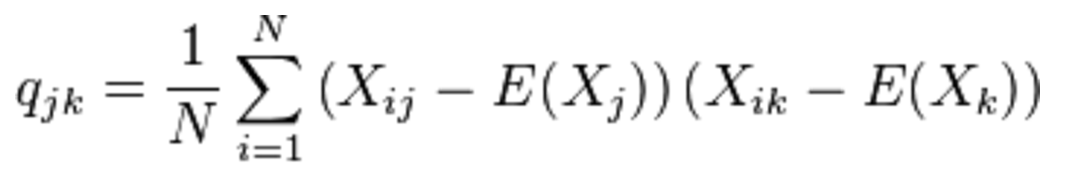
Covariance
Used to find relationships between dimensions in high dimensional data sets
The Sample mean

Slide 22
Eigenvector and Eigenvalue
Ax = λx
A: Square Matrix
λ: Eigenvector or characteristic vector
X: Eigenvalue or characteristic value
The zero vector can not be an eigenvector
The value zero can be eigenvalue

Slide 23
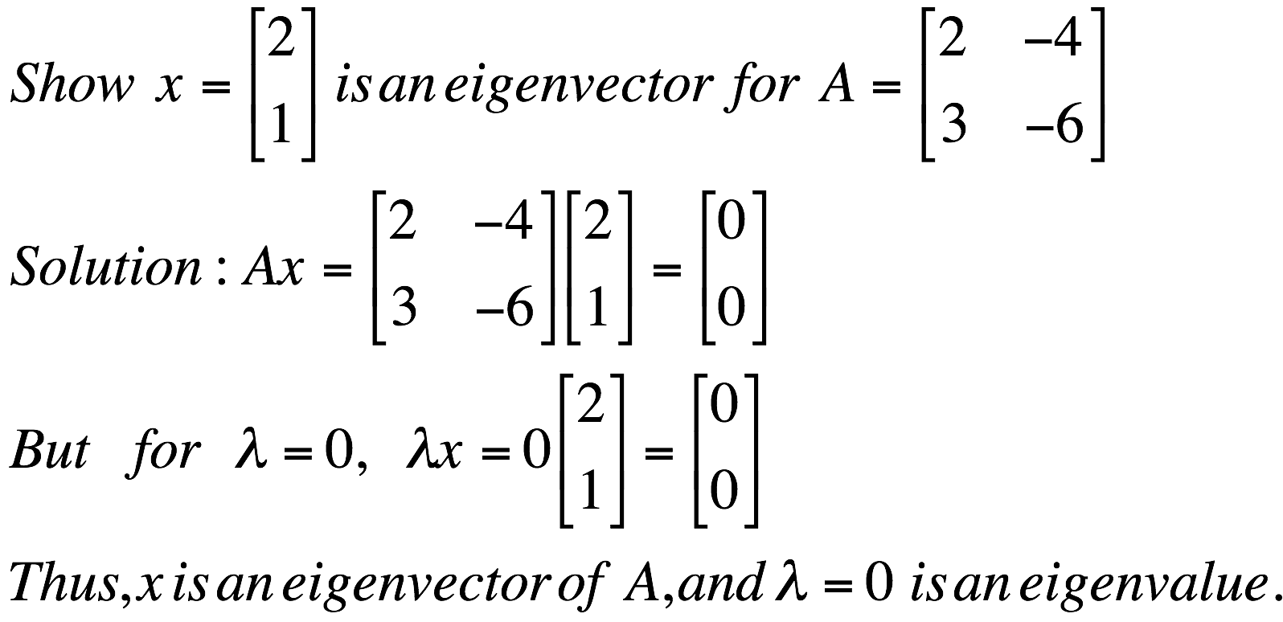
Eigenvector and Eigenvalue
Ax = λx
A: Square Matrix
λ: Eigenvector or characteristic vector
X: Eigenvalue or characteristic value
Example

Slide 24

Eigenvector and Eigenvalue
Ax - λx = 0
(A – λI)x = 0
Ax = λx
B = A – λI
Bx = 0
If we define a new matrix B:
x = B⁻¹0 = 0
BUT! an eigenvector cannot be zero!!
If B has an inverse:
x will be an eigenvector of A if and only if B does not have an inverse, or equivalently det(B)=0 :
det(A – λI) = 0

Slide 25
Eigenvector and Eigenvalue
Example 1: Find the eigenvalues of
two eigenvalues: −1, − 2
Note: The roots of the characteristic equation can be repeated. That is, λ₁ = λ₂ =…= λ_{k}. If that happens, the eigenvalue is said to be of multiplicity k.
Example 2: Find the eigenvalues of
λ = 2 is an eigenvector of multiplicity 3.

Slide 26
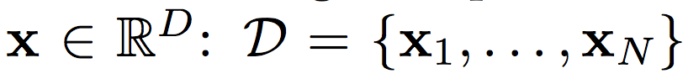
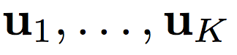
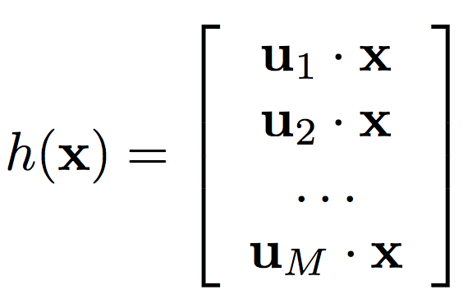
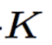
Principal Component Analysis
Input:
Set of basis vectors:
Summarize a D dimensional vector X with K dimensional feature vector h(x)

Slide 27
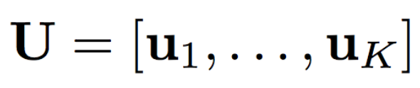
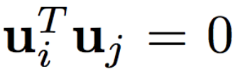
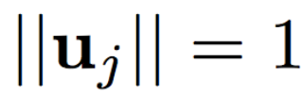
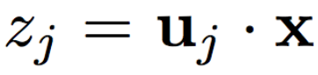
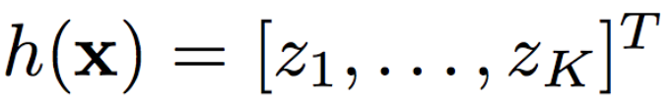
Principal Component Analysis
Basis vectors are orthonormal
New data representation h(x)

Slide 28
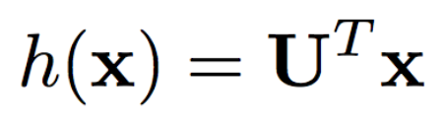
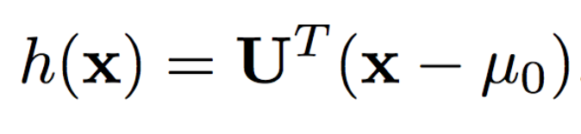
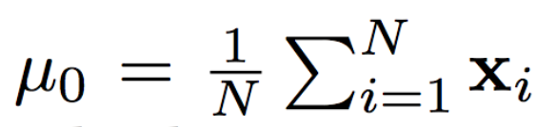
Principal Component Analysis
New data representation h(x)
Empirical mean of the data

Slide 29
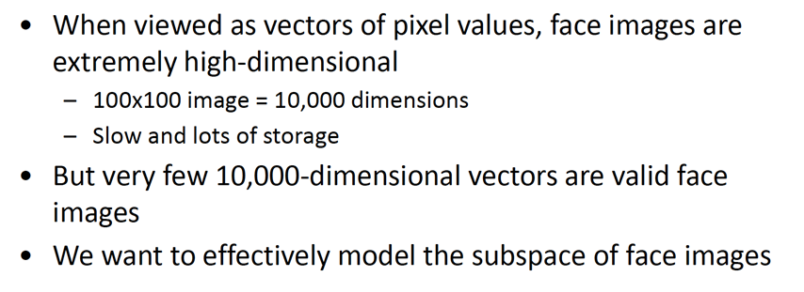
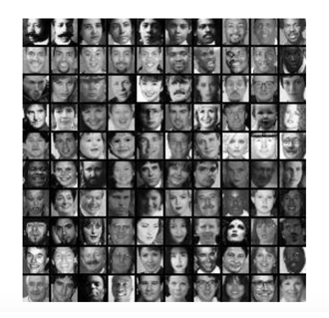
The space of all face images

Slide 30
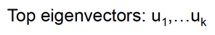
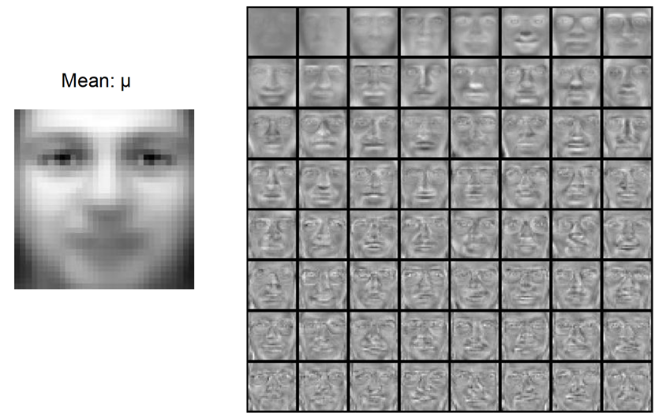
Eigenfaces example

Slide 31
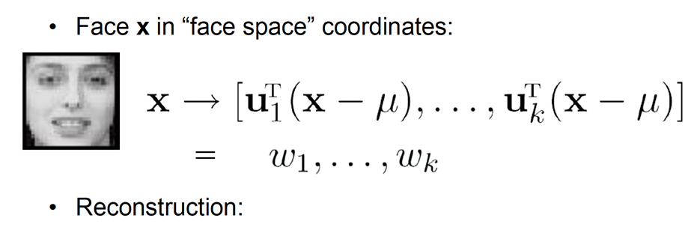
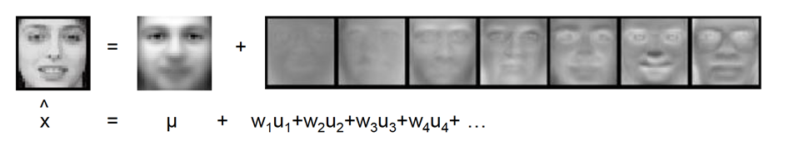
Representation and reconstruction

Slide 32
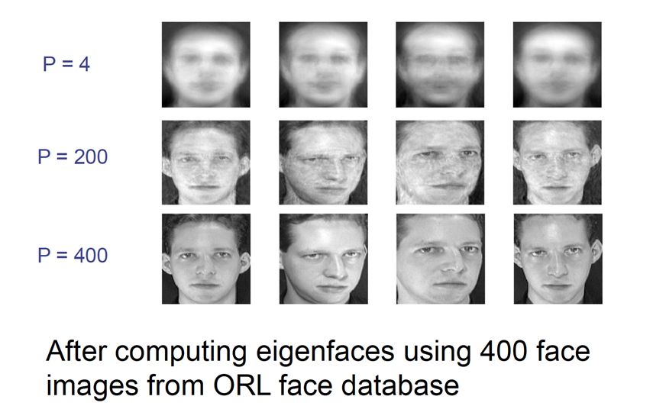
Reconstruction

Slide 33
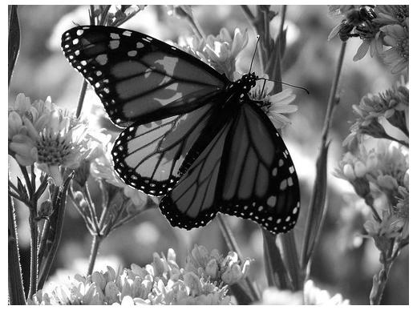
Application: Image Compression
Divide the original 372x492 image into patches:
Each patch is an instance that contains 12x12 pixels on a grid
View each as a 144-D vector

Slide 34
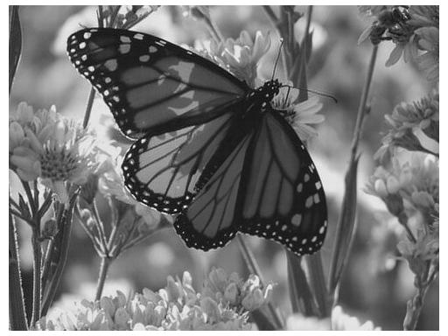
PCA compression: 144D → 60D

Slide 35

PCA compression: 144D → 16D

Slide 36
16 most important eigenvectors

Slide 37

PCA compression: 144D -> 6D

Slide 38
6 most important eigenvectors

Slide 39

PCA compression: 144D → 3D

Slide 40
3 Most important eigenvectors

Slide 41

PCA compression: 144D → 1D

Slide 42
Thank You!
In our next segment: K-Means Clustering

Slide 43
K Means Clustering
Dr. Sugata Ghosal
CSIS Off-Campus Faculty
BITS Pilani

Slide 44
In This Session
What is K Means Clustering?
Illustration
Formulation
Image segmentation Example
Characteristics

Slide 45

K-means Algorithm
Goal: represent a data set in terms of K clusters each of which is summarized by a prototype
Initialize prototypes, then iterate between two phases:
E-step: assign each data point to nearest prototype
M-step: update prototypes to be the cluster means
Simplest version is based on Euclidean distance
Rescaling of features is also an option

Slide 46

K-Means: Step by Step

Slide 47

K-Means: Step by Step

Slide 48

K-Means: Step by Step

Slide 49

K-Means: Step by Step

Slide 50

K-Means: Step by Step

Slide 51

K-Means: Step by Step

Slide 52

K-Means: Step by Step

Slide 53

K-Means: Step by Step

Slide 54

K-Means: Step by Step

Slide 55



1 of K coding mechanism
For each data point x_{n}, we introduce a set of binary indicator variables
such that
where k =1,...,K describing which of the K clusters the data point x_{n} is assigned to, so that if data point x_{n} is assigned to cluster k then r_{nk} =1, and r_{nj} =0 for j not equal to k.
Example: 5 data points and 3 clusters

Slide 56

K-means Cost Function
data
responsibilities
prototypes

Slide 57



Minimizing the Cost Function
E-step: minimize J w.r.t.
M-step: minimize J w.r.t
Convergence guaranteed since there is a finite number of possible settings for the responsibilities

Slide 58

Impact of number of clusters
Number of clusters

Slide 59


Example: Segmentation of Synthetic Image
white pixels
3
pixel count
black pixels
gray
pixels
1
2
input image
intensity
These intensities define the three groups.
We could label every pixel in the image according to which of these primary intensities it is.
i.e., segment the image based on the intensity feature.
What if the images are not quite so simple!

Slide 60


Real Image Segmentation
Now how to determine the three main intensities that define our groups?
We need to cluster.
pixel count
pixel count
input image
intensity

Slide 61


K Means Clustering – E Step
0
190
intensity
255
3
1
2
Goal: choose three “centers” as the representative intensities, and label every pixel according to which of these centers it is nearest to.
Best cluster centers are those that minimize SSD between all points and their nearest cluster center c_{i}:

Slide 62



K Means Clustering – M Step
With this objective, it is a “chicken and egg” problem:
– If we knew the cluster centers, we could allocate points to groups by assigning each to its closest center.
– If we knew the group memberships, we could get the centers by computing the mean per group.

Slide 63
Basic idea: randomly initialize the k cluster centers, and iterate between the two steps we just saw.
Randomly initialize the cluster centers, c₁, ..., c_{K}
Given cluster centers, determine points in each cluster
For each point p, find the closest c_{i}. Put p into cluster i
Given points in each cluster, solve for c_{i}
Set c_{i} to be the mean of points in cluster i
If c_{i} have changed, repeat Step 2
Properties
Will always converge to some solution
Can be a “local minimum” of objective:

Slide 64

Ask user how many clusters to use?
e.g., k=5

Slide 65

Ask user how many clusters to use?
e.g., k=5
Randomly guess 5 cluster centers

Slide 66

Ask user how many clusters to use?
e.g., k=5
Randomly guess 5 cluster centers
Each data points finds the cluster center it is closest to!

Slide 67

Ask user how many clusters to use?
e.g., k=5
Randomly guess 5 cluster centers
Each data points finds the cluster center it is closest to!
Each center finds centroid of data points it owns

Slide 68

Ask user how many clusters to use?
e.g., k=5
Randomly guess 5 cluster centers
Each data points finds the cluster center it is closest to!
Each center finds centroid of data points it owns
And jump there!
Repeat until terminated

Slide 69
Computational Complexity
Let n = number of instances, d = dimensionality of the features, k = number of clusters
Assume computing distance between two instances is O(d)
Reassigning clusters:
O(kn) distance computations, or O(knd)
Computing centroids:
Each instance vector gets added once to a centroid: O(nd)
Assume these two steps are each done once for a fixed number of iterations I: O(Iknd)
Linear in all relevant factors

Slide 70



K-means: pros and cons
Pros
Simple, fast to compute
Converges to local minimum of
within-cluster squared error
Cons/issues
Setting k?
Sensitive to initial centers
Use heuristics or output of another method
Sensitive to outliers
Detects spherical clusters
Adapted from K. Grauman

Slide 71
Thank You!
In our next segment: Gaussian Mixture Model

Slide 72
Gaussian Mixture Model
Dr. Sugata Ghosal
CSIS Off-Campus Faculty
BITS Pilani

Slide 73
In This Segment
Model Based Clustering
Gaussian Distribution
Parameter Estimation using MLE
Mixture of Gaussian
Parameter Estimation using Expectation Maximization

Slide 74
Model-based clustering
In order to understand our data, we will assume that there is a generative process (a model) that creates/describes the data, and we will try to find the model that best fits the data.
Models of different complexity can be defined, but we will assume that our model is a distribution from which data points are sampled
Example: the data is the income of all people in a country
In most cases, a single distribution is not good enough to describe all data points: different parts of the data follow a different distribution
Example: the data is the income of all people in countries G and C
We need a mixture model
Different distributions correspond to different clusters in the data.

Slide 75


Gaussian Distribution
Example: the data is the income of all people in country G
Experience has shown that this data follows a Gaussian (Normal) distribution
Reminder: Normal distribution:
$μ$= mean, $σ$= standard deviation
$$P\left(x\right)= \frac{1}{\sqrt{2π}σ}e^{−\frac{{\left(x−μ\right)}^{2}}{2σ^{2}}}$$

Slide 76

Gaussian Model
What is a model?
A Gaussian distribution is fully defined by the mean $μ$and the standard deviation $σ$
We define our model as the pair of parameters $θ = (μ, σ)$
This is a general principle: a model is defined as a vector of parameters $θ$

Slide 77

Fitting the model
We want to find the normal distribution that best fits our data
Find the best values for $μ$and $σ$
But what does best fit mean?

Slide 78



Maximum Likelihood Estimation (MLE)
Suppose that we have a vector $X=(x_{1},…,x_{n})$of values
And we want to fit a Gaussian $N(μ,σ)$model to the data
Probability of observing point $x_{i}$:
Probability of observing all points (assume independence)
We want to find the parameters $θ = (μ, σ)$that maximize the probability $P(X|θ)$
$$P\left(x_{i}\right)= \frac{1}{\sqrt{2π}σ}e^{−\frac{{\left(x_{i}−μ\right)}^{2}}{2σ^{2}}}$$
$$P\left(X\right)= \prod_{i=1}^{n}{P\left(x_{i}\right)}=\prod_{i=1}^{n}{\frac{1}{\sqrt{2π}σ}e^{−\frac{{\left(x_{i}−μ\right)}^{2}}{2σ^{2}}}}$$

Slide 79





Maximum Likelihood Estimation (MLE)
The probability $P(X|θ)$as a function of $θ$is called the Likelihood function
It is usually easier to work with the Log-Likelihood function
Maximum Likelihood Estimation
Find parameters $μ, σ$that maximize $LL(θ)$
$$L(θ)=\prod_{i=1}^{n}{\frac{1}{\sqrt{2π}σ}e^{−\frac{{\left(x_{i}−μ\right)}^{2}}{2σ^{2}}}}$$
$$LL\left(θ\right)=−\sum_{i=1}^{n}{\frac{{\left(x_{i}−μ\right)}^{2}}{2σ^{2}}−\frac{1}{2}n\log{2π}−n\log{σ}}$$
$$μ= \frac{1}{n}\sum_{i=1}^{n}{x_{i}=μ_{X}}$$
$$σ^{2}= \frac{1}{n}\sum_{i=1}^{n}{{{(x}_{i}−μ)}^{2} }=σ_{X}^{2}$$
Sample Mean
Sample Variance

Slide 80

MLE
Note: these are also the most likely parameters given the data
$$P\left(θ | X\right)=\frac{P\left(X | θ\right)P(θ) }{P(X)}$$
If we have no prior information about $θ$, or X, then maximizing $P\left(X | θ\right)$ is the same as maximizing $P\left(θ | X\right)$

Slide 81

MLE of Mean and Std. Deviation

Slide 82

Mixture of Gaussians
Suppose that you have the incomes of people from countries G and C and the distribution looks like the figure below (dramatization)

Slide 83
Mixture of Gaussians
In this case the data is the result of the mixture of two Gaussians
One for income of country G, and one for C
Identifying for each value which Gaussian is most likely to have generated it will give us a clustering.

Slide 84

Mixture model
A value $x_{i}$ is generated according to the following process:
First select the country
With probability $π_{G}$ select G, with probability $π_{C}$ select C $(π_{G} +π_{C} = 1)$
Given the country, generate the point from the corresponding Gaussian
$P\left(x_{i} | θ_{G}\right) \sim N\left(μ_{G},σ_{G}\right)$if G
$P\left(x_{i} | θ_{G}\right) \sim N\left(μ_{G},σ_{G}\right)$if C
We can also think of this as a Hidden Variable Z

Slide 85

Mixture Model
Our model has the following parameters
$$Θ=(π_{G},π_{C},μ_{G},μ_{C}, σ_{G},σ_{C })$$
For value $x_{i}$, we have:
$$P\left(x_{i}|Θ\right)=π_{G}P\left(x_{i} | θ_{G}\right)+π_{C}P(x_{i}|θ_{C})$$
For all values $X = \left(x_{1},…,x_{n}\right)$
$$P\left(X|Θ\right)= \prod_{i=1}^{n}{P(x_{i}|Θ)}$$
We want to estimate the parameters that maximize the Likelihood of the data
Mixture probabilities
Distribution Parameters

Slide 86

Mixture Models
Once we have the parameters $Θ=(π_{G},π_{C},μ_{G},μ_{C}, σ_{G},σ_{C})$ we can estimate the membership probabilities $P\left(G | x_{i}\right)$ and $P\left(C | x_{i}\right)$for each point $x_{i}$:
This is the probability that point $x_{i}$ belongs to the country G or C population (cluster)
$$P\left(G | x_{i}\right)= \frac{P\left(x_{i} | G\right)P(G)}{P\left(x_{i} | G\right)P\left(G\right)+P\left(x_{i} | C\right)P(C)} =\frac{P\left(x_{i} | G\right)π_{G}}{P\left(x_{i} | G\right)π_{G}+P\left(x_{i} | C\right)π_{C}}$$

Slide 87








EM (Expectation Maximization) Algorithm
Initialize the values of the parameters in $Θ$to some random values
Repeat until convergence
E-Step: Given the parameters $Θ$estimate the membership probabilities $P\left(G | x_{i}\right)$ and $P\left(C | x_{i}\right)$
M-Step: Compute the parameter values that (in expectation) maximize the data likelihood
$$π_{G}=\frac{1}{n}\sum_{i=1}^{n}{P(G|x_{i})}$$
$$π_{C}=\frac{1}{n}\sum_{i=1}^{n}{P(C|x_{i})}$$
Fraction of population in G,C
$$μ_{C}= \sum_{i=1}^{n}{\frac{P\left(C | x_{i}\right)}{n{∗π}_{C}}x_{i}}$$
$$μ_{G}= \sum_{i=1}^{n}{\frac{P\left(G | x_{i}\right)}{n{∗π}_{G}}x_{i}}$$
MLE Estimates
if $π$’s were fixed
$$σ_{C}^{2}= \sum_{i=1}^{n}{\frac{P\left(C | x_{i}\right)}{n{∗π}_{C}}{\left(x_{i}−μ_{C}\right)}^{2}}$$
$$σ_{G}^{2}= \sum_{i=1}^{n}{\frac{P\left(G | x_{i}\right)}{n{∗π}_{G}}{\left(x_{i}−μ_{G}\right)}^{2}}$$

Slide 88
Relationship to K-means
E-Step: Assignment of points to clusters
K-means: hard assignment, EM: soft assignment
M-Step: Computation of centroids
K-means assumes common fixed variance (spherical clusters)
EM: can change the variance for different clusters or different dimensions (ellipsoid clusters)
If the variance is fixed then both minimize the same error function

Slide 89

EM-Based Clustering

Slide 90

EM-Based Clustering

Slide 91


Mixture Vs. K-Means Clustering

Slide 92
In This Session
Probabilistic Clustering
Issues with K – means clustering
Review of Gaussian Distribution
Mixture of Gaussian Model
Formulation

Slide 93
Probabilistic Clustering
Represent the probability distribution of the data as a mixture model
captures uncertainty in cluster assignments
gives model for data distribution
Bayesian mixture model allows us to determine K
Consider mixtures of Gaussians

Slide 94



Review: Gaussian Distribution
Chris Bishop

Slide 95



Mixtures of Gaussians
Combine simple models into a complex model:
Component Mixing coefficient
K=3
Find parameters through EM (Expectation Maximization) algorithm
Adapted from Chris Bishop

Slide 96


Probabilistic version: Mixtures of Gaussians
Old Faithful data set
Single Gaussian
Mixture of two
Gaussians
Chris Bishop

Slide 97

Gaussian Mixture Model
Data set
Consider first a single Gaussian
Assume observed data points generated independently
Viewed as a function of the parameters, this is known as the likelihood function

Slide 98



The Gaussian Distribution
Multivariate Gaussian
mean
covariance
x
2
x
2
x
2
x
1
x
1
x
1
(a)
(b)
(c)

Slide 99
Gaussian Mixture Model
K-dimensional binary random variable z having a 1-of-K representation in which a particular element z_{k} is equal to 1 and all other elements are equal to 0.
The values of z_{k} therefore satisfy z_{k} ∈{ 0,1}
K possible states for the vector z according to which element is nonzero.
Joint distribution p(x,z) in terms of a marginal distribution p(z) and a conditional distribution p(x|z),
Marginal distribution over z is speciﬁed in terms of the mixing coefﬁcients π_{k}, such that p(z_{k} = 1) =π_{k}

Slide 100


Sampling from the Gaussian
To generate a data point:
first pick one of the components with probability
then draw a sample from that component
Repeat these two steps for each new data point

Slide 101
Fitting the Gaussian Mixture
We wish to invert this process – given the data set, find the corresponding parameters:
mixing coefficients
means
covariances
If we knew which component generated each data point, the maximum likelihood solution would involve fitting each component to the corresponding cluster
Problem: the data set is unlabelled
We shall refer to the labels as latent (= hidden) variables

Slide 102





Gaussian Mixture Model
Linear super-position of Gaussians
Normalization and positivity require
Can interpret the mixing coefficients as prior probabilities

Slide 103



Gaussian Mixture Model
z uses a 1-of-K representation, we can also write this distribution in the form
Conditional distribution of x given a particular value for z is a Gaussian
Joint distribution is given by p(z)p(x|z), and the marginal distribution of x is then obtained by summing the joint distribution over all possible states of z to given

Slide 104

Gaussian Mixture Model
Conditional probability of z given x
use γ(z_{k}) to denote p(z_{k} =1 | x), whose value can be found using Bayes’ theorem
π_{k} as the prior probability of z_{k} =1, and the quantity γ(z_{k}) as the corresponding posterior probability once we have observed x.

Slide 105

Maximum Likelihood
Log of likelihood function:
Maximizing the log likelihood function for a Gaussian mixture model turns out to be a more complex problem than for the case of a single Gaussian.
The difﬁculty arises from the presence of the summation over k that appears inside the logarithm, so that the logarithm function no longer acts directly on the Gaussian.

Slide 106
GMM Problems and Solutions
How to maximize the log likelihood
solved by expectation-maximization (EM) algorithm
How to avoid singularities in the likelihood function
solved by a Bayesian treatment
How to choose number K of components
also solved by a Bayesian treatment

Slide 107



Expectation Maximization Algorithm
Conditions for MLE: Setting the derivatives of ln p(X|π,µ,Σ) with respect to the means µk of the Gaussian components to zero, we obtain
rearranging we obtain:
where we have deﬁned

Slide 108

µ_{k} for the kth Gaussian component is obtained by taking a weighted mean of all of the points in the data set
Weighting factor for data point x_{n} is given by the posterior probability γ(z_{nk}) that component k was responsible for generating xn
If we set the derivative of ln p(X|π,µ,Σ) with respect to Σ_{k} to 0, and follow a similar line of reasoning, making use of the result for the maximum likelihood solution for the covariance matrix of a single Gaussian

Slide 109



Maximize ln p(X|π,µ,Σ) with respect to the mixing coefﬁcients π_{k} with constraint
Using a Lagrange multiplier and maximizing the following quantity
which gives
If we now multiply both sides by πk and sum over k, we ﬁnd λ = −N.
Rearranging we obtain

Slide 110
We ﬁrst choose some initial values for the means, covariances, and mixing coefﬁcients.
Then we alternate between the following two updates known as the E step and the M step
In the expectation step, or E step, we use the current values for the parameters to evaluate the posterior probabilities,
Then use these probabilities in the maximization step, or M step, to re-estimate the means, covariances, and mixing
In practice, the algorithm is deemed to have converged when the change in the log likelihood function, or alternatively in the parameters, falls below some threshold

Slide 111
EM Algorithm – Informal Derivation
The solutions are not closed form since they are coupled
Suggests an iterative scheme for solving them:
make initial guesses for the parameters
alternate between the following two stages:
E-step: evaluate responsibilities
M-step: update parameters using ML results
Each EM cycle guaranteed not to decrease the likelihood

Slide 112

Initialization
E step
M step
Figures from Chris Bishop

Slide 113
Example: Mixture of 3 Gaussians
1
0.5
0
0
0.5
1
(a)

Slide 114
Contours of Probability Distribution
1
0.5
0
0
0.5
1
(b)

Slide 115

Surface Plot

Slide 116

Synthetic Data Set
1
0.5
0
0
0.5
1
(a)

Slide 117

Synthetic Data Set Without Labels
1
0.5
0
0
0.5
1
(b)

Slide 118


Posterior Probabilities
We can think of the mixing coefficients as prior probabilities for the components
For a given value of we can evaluate the corresponding posterior probabilities, called responsibilities
These are given from Bayes’ theorem by

Slide 119

Posterior Probabilities (colour coded)
1
0.5
0
0
0.5
1
(a)

Slide 120

EM algorithm for GMM
Initialize the means µ_{k}, covariances Σ_{k} and mixing coefﬁcients π_{k}
evaluate the initial value of the log likelihood.
E step: Evaluate the responsibilities using the current parameter values

Slide 121



EM algorithm for GMM
4. M step: Re-estimate the parameters using the current responsibilities
where
5. Evaluate the log likelihood

Slide 122
Thank You!
In our next session: Neural Network

